Slide 1
Everyone a Partner
Reinvigorating CE through (re)new(ed) staff and community partnerships
Cindy Fesemyer
Director, Columbus (WI) Public Library
Assoc Lecturer & CE Instructor, UW Madison iSchool
Trustee, Madison Public Library

Slide 2
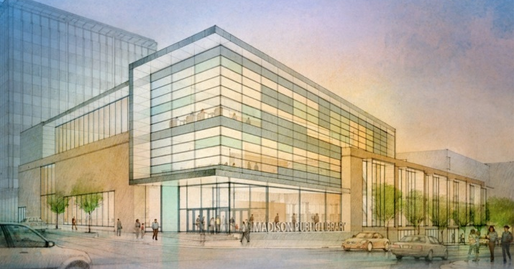
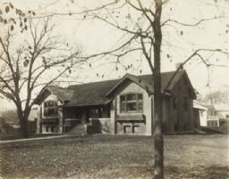
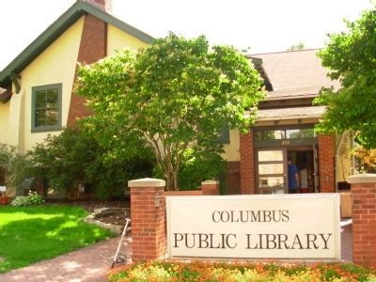
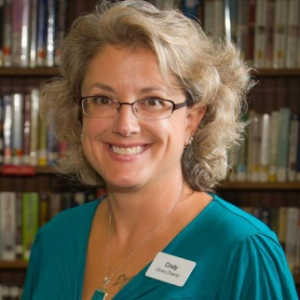
Columbus Public Library, Wisconsin
Innovation
Tradition
New Girl

Slide 3
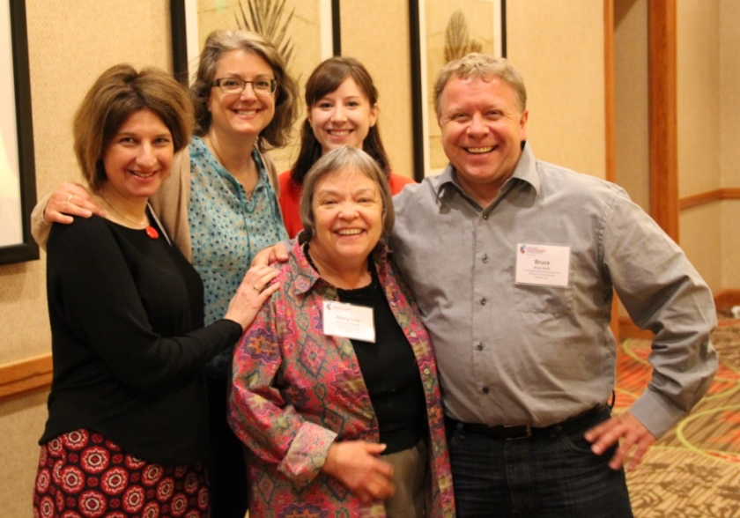
The Columbus Story
Libraries Transforming Communities, ALA, the Harwood Institute &
the Aspen Action Guide

Slide 4
Harwood in Denver
Libraries Transforming Communities cohort libraries:
Red Hook (N.Y) Public Library (pop: 1,900) | Springfield (Mass). Public Library (pop: 153,000)
Columbus (Wis.) Public Library (pop: 5,000) | Tuscaloosa (Ala.) Public Library (pop:195,000)
Knox County (Ind.) Public Library (pop: 33,900) | Spokane County (Wash.) Library District (pop: 255,000)
Suffolk (Va.) Public Library (pop: 85,000) | San Jose (Calif.) Public Library (pop: 980,000)
Hartford (Conn.) Public Library (pop: 125,000) | Los Angeles (Calif.) Public Library (pop: 3.8 million)

Slide 5
Libraries Transforming Communities
LTC was a grant initiative of the American Library Association (ended Dec. 1, 2015)
In partnership with nonprofit Harwood Institute for Public Innovation
Funded by the Bill & Melinda Gates Foundation
Sought to strengthen libraries’ roles as core community leaders and change agents.

Slide 6
turn outward {verb}
The act of seeing and hearing those in the community and acting with intentionality to create change;
A reorientation toward the public; a posture;
A framework for making choices about public life.
Notes:
HARWOOD

Slide 7
Identify Community Aspirations: What’s your fave Harwood tool?
ASK Exercise
Aspirations Exercise
Turn Outward Quiz
Community Conversations
Notes:
HARWOOD

Slide 8
Identify Community Capacity for Change: My fave tool
Notes:
HARWOOD IN COL

Slide 9
The Sweet Spot

Slide 10
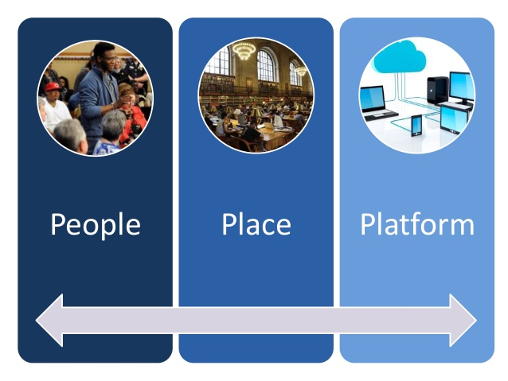
Identify Library Assets
Technology
Notes:
HARWOOD IN COL

Slide 11
The Library Sweet Spot
COMMUNITY
LIBRARY SWEET SPOT
Library Capabilities

Slide 12
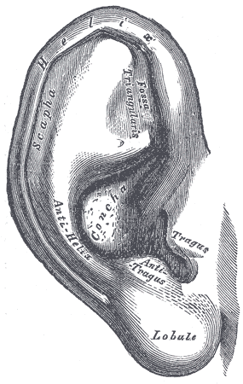
What we heard
Columbus wants a welcome and vibrant community for all.
They talk about the lack of opportunity for boundary-crossing social interaction and a desire for civic pride.

Slide 13
What we are doing
Root for Columbus Action Potluck
This PROGRAM brings the combined resources of the library and the city to the table.
Library as CONVENOR
Provides:
Meeting space in town
Assistance in creating the agenda
Trained facilitators
Accountability
Communication
Library as AGENT OF CHANGE
Notes:
COL RESULTS

Slide 14
Root for Columbus PROJECTS

Slide 15
What we heard
Columbus wants a viable and walkable downtown.
We knew the Chamber of Commerce and Columbus Downtown Development Corp. (CDDC) didn’t always get along.

Slide 16
What we are doing
James Street Reconstruction:
We’re in it Together!
PARTNERS with other organizations
CONVENES gatherings
COMMUNICATES throughout the process
Helps raise up LEADERS in the business community

Slide 17
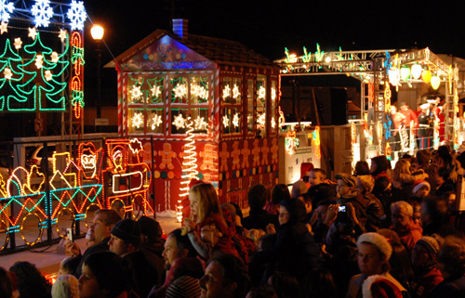
What we are doing
What we are doing
hat we are doing
2016 Holiday Train Warm Up
COLLABORATE ON CHANGE Partners: Library, Columbus Recreation, Chamber of Commerce, CDDC, City Tourism Committee, local businesses, fire & police, schools

Slide 18
What we heard
Columbus wants more opportunities for diverse social interaction,
And more stuff to do for kids and teens.
They say an organized space for interaction with help achieve that aspiration.

Slide 19
What we are doing
Strategic Plan 2015
MISSION: The Columbus Public Library promotes a vibrant & welcoming community by connecting people, information & ideas to enhance the regional quality of life.
GOALS
Communication
Be a communication conduit for the whole community
Programming
Give ‘em what they want, what they really, really want
Welcoming environment
Create it and maintain it
Physical space
Get more!
Multi-use space: Will be explored with potential community partners
Notes:
COL RESULTS

Slide 20
What we are doing
What we are doing
hat we are doing

Slide 21
What we are doing
Municipal electeds and administrative staff want a plan for growth before committing to a library expansion, but they don’t know how to start
Currently working with Mayor, City Council, and City Administrator to add $100,000 to 2018 Capital Improvement Plan

Slide 22
Resources
ALA’s Libraries Transforming Communities
View a free, 60-minute webinar about how three libraries are using the "turning outward" approach: "Go Out & Play: Community Engagement through Turning Outward“
"A Step-by-Step Guide to 'Turning Outward' to Your Community“
The Aspen Report: Rising to the Challenge: Re-Envisioning Public Libraries
Action Guide for Re-Envisioning Your Public Library

