Slide 1
Academic Library Contribution to Campus Community Engagement
Scott M. Sandberg, M.L.I.S.
Assistant Digital Scholarship & Adaptive Technologies Librarian
Indiana University Northwest, Gary, Indiana
Notes:
Thank you much for attending my MCLS Community Engagement Reboot presentation. I hope you will find the information interesting and worthwhile, and we will be sure to leave time for any questions you might have. My name is Scott Sandberg, Digital Scholarship and Adaptive Technologies Librarian at a urban regional campus of Indiana University, IU Northwest in Gary. This session will focus
on community engagement activities by an academic library, activities coordinated within a broader university campus’ plan and activities relating to community engagement. For the past 15 years, the Library, at IU Northwest, has supported, mostly with external funding, a service called the Northwest Indiana Center for Data and Analysis, or “Library Geographic Data Center” for short. The Geographic Data Center began fittingly with a 2 year startup internal grant from an Indiana University wide Strategic Directions initiative. The Library proposed that startup funding be provided to create a Library service that would provide value added demographic data services to support various economic development and quality of life projects in Gary and Northwest Indiana. The proposal stated that after initial startup support the Center would become largely self sustaining through external grants and contracts

Slide 2
IU Northwest and Community Engagement
Academic Affairs – CURE
Arts & Sciences – Science Olympiad
Business & Economics – Center for Mgmt. Dev. & VITA
Continuing Studies – Glen Park Conversations & Kids College
School of Education – Urban Teacher Education Program (UTEP)
Health & Human Services – Public Affairs Week & Child Abuse Forum Prevention
IU School of Medicine Northwest - International Human Cadaver Prosection Program
Student Affairs – Career Fairs
Notes:
Various campus units at IU Northwest are involved in numerous community engagement activities. Our Academic Affairs office has created a Center for Urban and Regional Excellence (CURE) to help faculty and students engage with community needs. Within our College of Arts and Sciences the campus hosts an annual Science Olympiad for area high student students. The Olympiad focuses on friendly competition around fun science projects. Our School of Business and Economics has a Center for Management Development that provides professional continuing education training from Business school faculty. A VITA (Volunteer Income Tax Assistance) program involves Business School faculty and students providing tax season assistance to community assistance to those who cannot afford a tax preparer. Our Continuing Studies program hosts a summer Kids College program and along with the Library host a Gary Glen Park neighborhood conversations series. The School of Education has a Urban Teacher Education Program that works specifically with teachers who wish to teach in area urban classrooms. The College of Health and Human Services and the School of Public and Environmental Affairs host an annual Public Affairs Week of activities involving the community and for 30 years have hosted an all day regional Child Abuse Prevention Summit on campus. The IU School of Medicine Northwest Campus provides campus medical school students with an International Human Cadaver Prosection Program that honors those who have donated their bodies upon death for research purposes. One final example are the campus and community Career Fairs hosted and coordinated with the Office of Student Affairs.

Slide 3
IU Northwest and Center for Urban & Regional Excellence (CURE)
Northwest Indiana Consortium for the Environment (NICE)
Northwest Indiana Restoration Monitoring Inventory
NonProfit Institute/South Shore Grants
Lilly Endowment Grants for Faculty Research
Carnegie Classification
Notes:
The Center for Urban and Regional Excellence (CURE) continues to develop and grow as the campus unit that coordinates community engagement on campus, especially those activities that involve faculty and students in action research and experiential learning. The Center sees an area university collaboration called NICE, the Northwest Indiana Consortium for the Environment. One current project is the Northwest Indiana Restoration Monitoring Project. Another project under the Center is the Nonprofit Institute and SouthShore Grants Office that provides grant seeking assistance and training for increasing the capacities of area not for profit organizations. Currently the campus has Lilly Endowment funding support that allows a faculty member to engage in community projects that involve IUN students and a community organization partner. Finally the campus recently chose as one of its priorities to work towards obtaining a Carnegie Classification for its ongoing community engagement efforts.

Slide 4
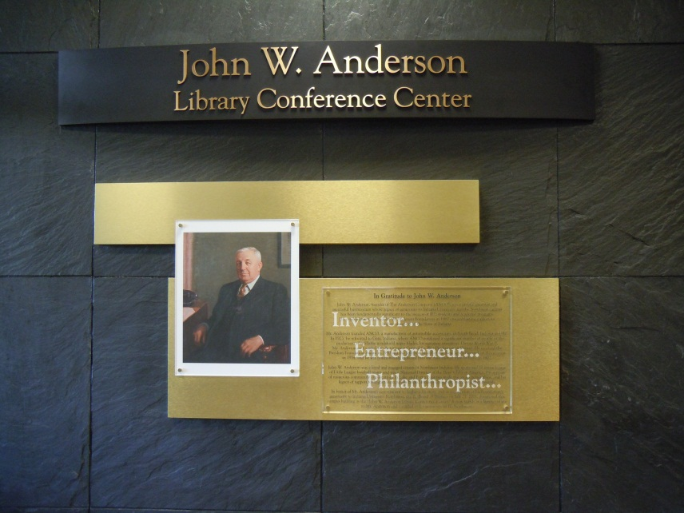
IUN Library and Community Engagement
Reference & Circulation Services for Community Patrons
Adaptive Technology
Diversity Library
Calumet Regional Archives
NWI Center for Data & Analysis
Hosting of Community Engagement Centers & Activities
Gary Glen Park Weed & Seed Crime Prevention Program
Reading in the Region: One Book, One Campus
Notes:
Now let me move to the community engagement activities of the Library at IU Northwest. The Anderson Library gives its highest priority to serving the information and research needs of its students and faculty. But just about all Library services are also eagerly offered to community users as well. About 1/5 of questions at the 2 Library Help Desks come from community patrons totaling about 2400 per year. The newest Library service, the Adaptive Technology software Room, is available for community users with disabilities as well as for our students with disabilities. The Diversity Library set of information resources exemplifies the fact that the Library staff and librarians are committed to diversity, and that staff are representative in race and ethnicity of the surrounding urban area. The Calumet Regional Archives dept. in the Library for the past 30 years has collected and made available the rich historical collections from the Calumet region of Indiana. A popular credit course about the history of Indiana, especially the northwest region is offered by the Archivist, and the Archivist travels throughout the region sharing the interesting and valuable history of this industrial region and well as the area’s environmental importance. Some of the Library’s building space is used to host campus centers devoted to engagement such as CURE (Center for Urban and Regional Excellence), South Shore Grants Center, and the Gary Glen Park Weed and Seed crime prevention Office. The Library also helps host community events such as the monthly Gary Glen Park Conversations program, a program that brings community leaders to highlight through discussion interesting activities occurring in the neighborhood and within the City of Gary. The Library’s Geographic Data Center is the community engagement focus for this presentation and will now be explored in some further detail.

Slide 5
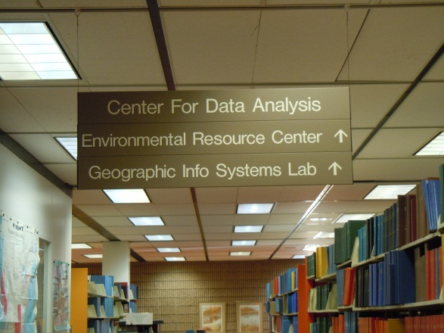
NWI Center for Data & Analysis (Library GIS Data Center)
Data Demographic Analysis
Environmental Resources Center
GIS Regional Office
Community Grants Information Center
Government Publications and Lake County Central Law Library
Notes:
The five aspects of the Geographic Data Center are 1) projects that provide local demographic data analysis, 2) access to information resources about urban environmental health, 3) GIS (geographic information systems) maps creation and display, 4) providing resources needed for grant seeking activities, and 5) provision of government and legal information to the public. As we explain the activities in these five areas, I will focus on one project I have been involved with in the past as an example of the numerous activities and projects undertaken over the years. This project has involved students, a faculty member, a community partner the Lake County Geminus social service organization, and a funder the Indiana State Dept. of Health, all working together to address substance abuse issues facing youth in East Chicago, Indiana.

Slide 6
Demographics Data Analysis
Census Data – Value Added
Northwest Indiana (Chicagoland and State of Indiana Characteristics)
Digital Data
Tabular/Graphical (GIS)
Census Tracts, Block Groups and Radius Data
Master’s Level Expertise
Notes:
The Northwest Indiana Center for Data and Analysis was created in 1996 with funding through the Indiana University Strategic Directions program. Work has involved assisting IU Northwest faculty and staff as well as various community clients over the years with their data needs. Demographic data for the region/state/nation are always needed for projects such as grant proposals and other types of reports. While this type of data exists online and is freely available through numerous government agencies, finding what you need can be time consuming. Once found, putting it into an appropriate format is another concern. Discovering raw data and then adding value to it by creating tabular or graphical elements plays a part in most of the Data Center’s activities. Over the years, the Data Center has also conducted Focus Groups and surveys for reporting comments and opinions on various issues.
The Data Center provided a variety of graphical elements for the 4 year project with the Geminus Corp. Demographic information was converted to charts, graphs and maps for inclusion in the East Chicago Local Epidemiology Profile annual reports. Data describing community ethnicity, school drop-out and graduation rates, unemployment information, numbers and types of substance abuse treatment, drug related crime data, population changes, community assets were included in tables, graphs and maps. In 2010 the Data Center facilitated a focus group with East Chicago Clergy to get their thoughts on the state of drug abuse and available treatment in the city. For 2011 report, a focus group was conducted with a neighborhood watch group within the city to get their views on how they perceive their neighborhood.

Slide 7
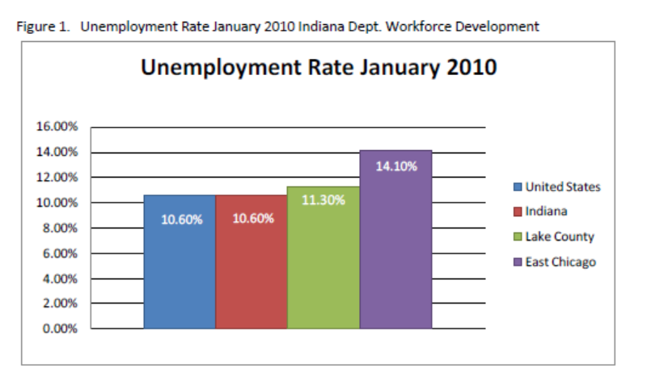
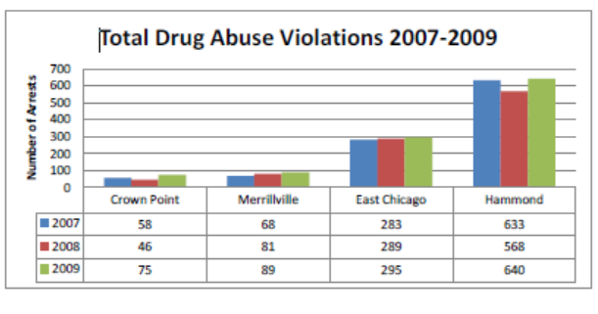
GEMINUS Project Consumption and Consequences of Cocaine and Other Drugs in East Chicago, Indiana: A Local Epidemiological Profile, 2008 - 2011
Source: Indiana Dept. of Education

Slide 8
Environmental Resources Center
Urban Environmental Health vs. Conservation/Preservation
Environmental Justice
Governmental Environment and Health Resources
Local Environment and Health Studies
Gary CARE & East Chicago Substance Abuse Prevention
Notes:
In 1997, the Environmental Resources Center was created with funding awarded to IU Northwest from the United States Environmental Protection Agency through its Environmental Justice Partnership program. Indiana University Northwest is one of the 10 universities nationwide that received such a grant. Environmental Justice refers to the perception that minority communities are burdened with more environmental risks than in other areas. While not a legal clinic, the center was intended to assist municipalities like East Chicago, Gary, and Hammond to educate residents about the pollution in their communities. The Resource Center collection contains various reports that describe the environmentally sensitive nature of the region related to past heavy industry that are available to the community and the campus.
Health issues can also arise do to the environmental quality of a region. We continue to participate with the Department of Environmental Affairs within the City of Gary, as they administer a US EPA Community Action Renewed Environment (CARE) Partnership grant. Discussions with citizens are ongoing about community occurrences of asthma and other respiratory ailments, low birth weight, diabetes, learning disabilities and heart disease.
Related to our Geminus project, data describing the number and types of drug treatment admissions in East Chicago was collected and graphically displayed during the four year project.

Slide 9
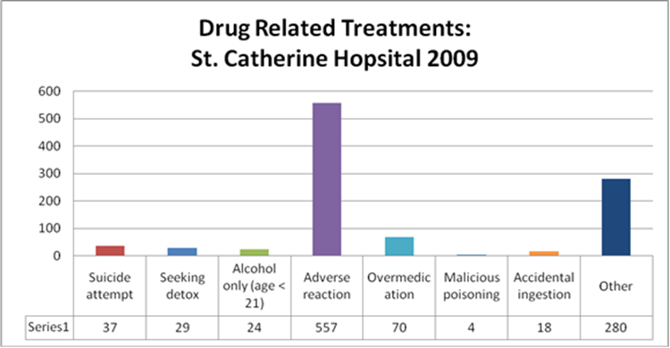
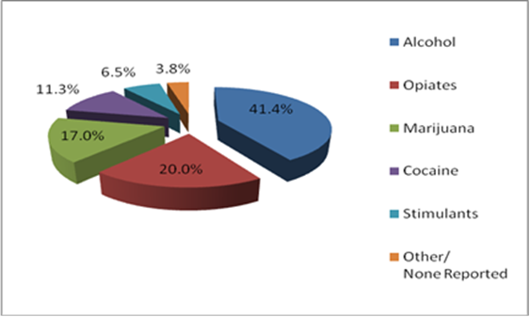
GEMINUS Project Consumption and Consequences of Cocaine and Other Drugs in East Chicago, Indiana: A Local Epidemiological Profile, 2008 - 2011

Slide 10
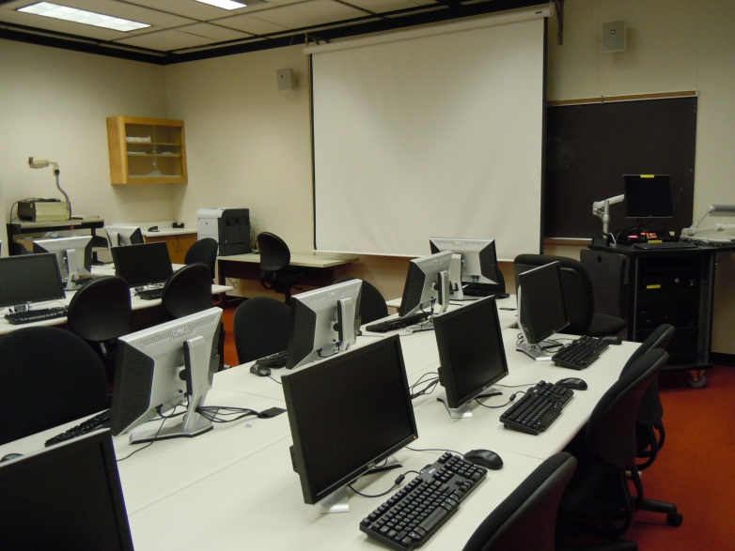
Geographic Information Systems Office
Northwest Indiana GIS Forum
Indiana Geographic Information Council (IGIC)
Software
Instructional Lab
Training and Courses
Notes:
Visualizing data in different manners has been a goal of the Data Center. Geographic Information Systems technology gained usage through the 1990’s and was investigated as another method to visualize data. Becoming familiar with the technology has been a valuable tool for the Data Center. What is GIS? Geographic Information Systems – A system to display, store, analyze, and manage information about objects on earth. It is a combination of computer generated graphics and database – Data that includes a location can be visualized.
In the mid to late 90’s, GIS technology began a transformation to a more user friendly interface. Prior to this time the technology was limited to use by those with heavy duty computer programing skills. Today it is a common presence. Google Earth is a common GIS application that is used by the masses. With a bit more training, using more sophisticated software such as ESRI ArcGIS provides a way to visualize common datasets such as census information.
Partnerships have always been an important element in our success as it relates to GIS. The Data Center began a partnership with the Northwest Indiana GIS Forum, first serving co-host and later, co-chairing the organization. Bimonthly meetings are held drawing participants from Lake, Porter, LaPorte, Newton, St. Joseph. The meetings are a good way to keep up to date with data that is being created in the region as well as providing networking possibilities. Besides our regional GIS Users Group, the Data Center also participates with the Indiana Geographic Information Council (IGIC). IGIC provides statewide coordination of Indiana GIS through dissemination of data and data products, education and outreach, adoption of standards, building partnerships and the online interactive mapping website, the IndianaMap. Participation IGIC provides links to numerous resources at a higher level to the Northwest Indiana GIS Forum.
In an effort to promote GIS technology at Indiana University Northwest, a library computer lab was converted to a GIS lab. Taking advantage of the academic lab licensing agreement between the software vendor and Indiana University ultimately created a fifteen seat computer lab. Benefiting the community, our GIS lab provides free training to regional GIS professionals through the partnership of several organizations. Sponsored through the NWI GIS Forum, the Hammond Sanitary District has supplied the certified trainer, IDEM furnishes the training materials and IUN provides the computer lab.
Other GIS education and outreach activities have been administrated by the Data Center as a result of several successful grant opportunities. Federal Grant dollars from the US EPA region 5 and the Federal Geographic Data Committee were used to teach local GIS personnel how to properly document data they create via geospatial metadata. Funding through the Lake Michigan Coastal Program designated for environmental resource education in the watershed was geared towards those with less familiarity of GIS as well as those with less available funding for purchasing pricy GIS resources.
The Data Center has also worked with the Geoscience Department to offer an intro to GIS college credit course for undergraduates. The Schools of Public and Environmental Affairs and Business and Economics have also used the GIS lab for credit GIS courses.
GIS turned out to be an integral part of our project with Geminus. Maps were created to visualize East Chicago demographics such as population change by census tract and community assets such as the locations of churches, schools and parks. In addition, the city police department provided the locations of drug related crimes that were mapped for each year for the annual reports. Crime mapping over the four year project indicated that drug related crime in a specific part of the city decreased over the time period. It was noted that in this neighborhood a crime watch group had been initiated at the beginning of the project period. As part of the outcomes for the project, it was stated that perhaps the decrease in neighborhood crime was a result of actions taken by the watch group. Creating additional neighborhood crime watch groups within the city might be an avenue to pursue as a way to decrease drug related crime.

Slide 11
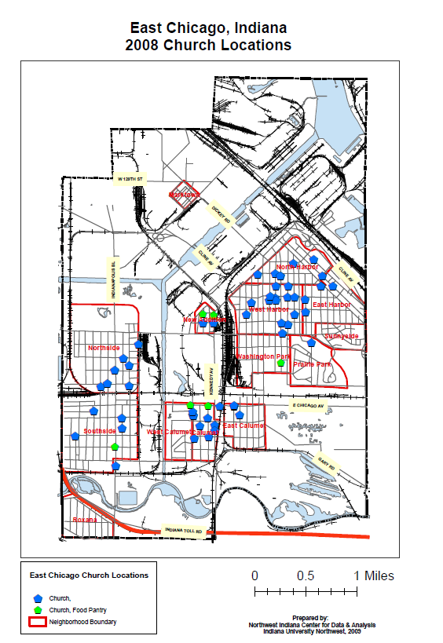
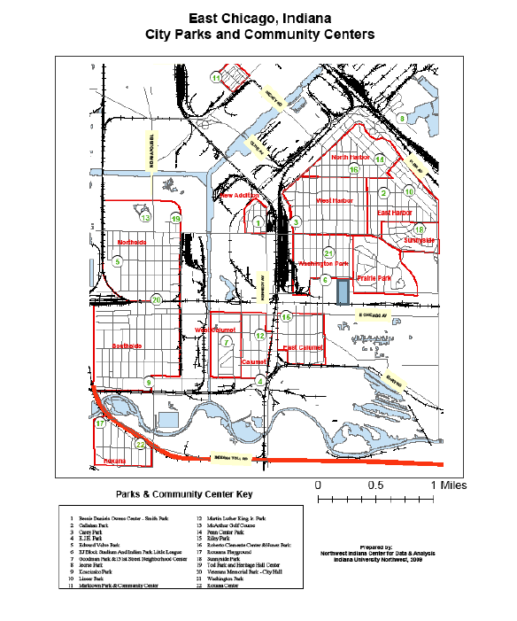
GEMINUS Project Consumption and Consequences of Cocaine and Other Drugs in East Chicago, Indiana: A Local Epidemiological Profile, 2008 - 2011
Geminus Project Examples

Slide 12
Community Grants Information Center
Foundation Center Cooperating Collection
Foundation Center Online
GrantsStation
Provide Grant Seeking Assistance with NPI/SouthShore Grants
Notes:
The Foundation Center Cooperating Collection which maintains the most comprehensive database on U.S. grant makers and their grants; issues a wide variety of print, electronic, and online information resources; conducts and publishes research on trends in foundation growth, giving, and practice; and offers an array of free and affordable educational programs.
The Foundation Center Online: The most authoritative source of information on private philanthropy in the United States.
GrantsStation to locate alternative funding sources for projects
And we Provide Grant Seeking Assistance with NPI/SouthShore Grants; dedicated to expanding the organizational capacity and fundraising skills of non-profit agencies serving children, families, and the disabled in Northwest Indiana.

Slide 13
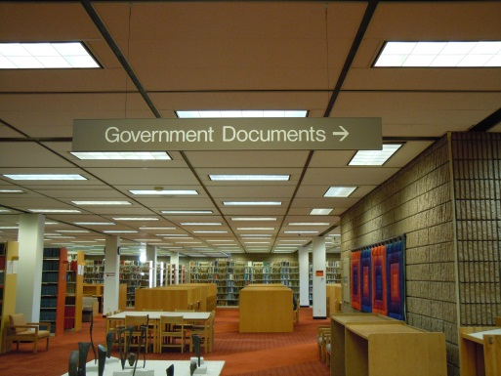
Government Publications & Lake County Central Law Library
Federal Depository Library System – Free, Not Copyrighted Info.
State of Indiana Government Information
INDIGO – Statewide Indiana Government Publication Librarians
Cases, Legal Forms, and Pro Bono Referral
Notes:
We also rely on government publications and the Lake County Central Law Library. In particular:
The Federal Depository Library System; the purpose of which is to provide free and unrestricted access to government information to the public.
The State of Indiana Government Information (AccessIndiana) which provides an electronic gateway to Indiana state government services and information
The Indiana Networking for Documents and Information of Government Organizations (INDIGO): The purpose of which, among other things, is to provide a forum for discussion of problems and concerns, and for exchanging ideas by librarians working with government information
And, the Lake County Central Law Library (Cases, Legal Forms, and Pro Bono Referral) which serves county and state employees; authorized legal practitioners and their staff; and the local community.

Slide 14
Community Partners
GEMINUS
Boys and Girls Clubs of Northwest Indiana
Gary CARE
Hammond Sanitary District
Indiana Department of Environmental Management (IDEM)
Northwestern Regional Planning Commission
Indiana Geological Survey
Northwest Indiana World Trade Council
NonProfit Institute/South Shore Grants
Gary Glen Park Weed and Seed Project
Notes:
These resources have enabled us to partner with various organizations in the community, including:
GEMINUS
The Boys and Girls Clubs of Northwest Indiana:
Gary CARE
The Hammond Sanitary District: partnered gis with the data center
The Indiana Department of Environmental Management (IDEM): also a partner, free training material for IUN (combine with HSD)
The Northwestern Regional Planning Commission (NIRPC): involvement with economic development
The Indiana Geological Survey: GIS connection; created LR GIS; assisted with updating the database; kept regional gis data up to date
The Northwest Indiana World Trade Council: served on b of direc; center created a survey to determine the products/services imported/exported to NWI
The NonProfit Institute/South Shore Grants: Ties in with Grant sites
The Gary Glen Park Weed and Seed Project: Mapping – provide space w/in library – provide data for proposals -

Slide 15
IU Northwest Campus Partners
School of Business and Economics (SOBE)
Community Garden
Center for Urban and Regional Excellence (CURE)
Northwest Indiana Consortium for the Environment (NICE)
School of Public and Environmental Affairs (SPEA)
Development Office
IU Foundation
Notes:
As well as with IU Northwest departments, events, and schools, including:
The School of Business and Economics (SOBE)
Community Garden
The Center for Urban and Regional Excellence (CURE)
The Northwest Indiana Consortium for the Environment (NICE)
The School of Public and Environmental Affairs (SPEA)
The Development Office
And the IU Foundation

Slide 16
Funders
Grants
Indiana University's 1996 Strategic Directions Initiative
U.S. EPA – Environmental Justice Office
Federal Geographic Data Committee
Lake Michigan Coastal Program
Indiana State Library/Institute of Museum and Library Services
NIPSCO Economic Development Department
Center for Urban and Regional Excellence/CURE
Contracts
Wildlife Habitat Council
Town of Highland Clerk Treasurer’s Office
Gary/Chicago Airport
Save the Dunes Conservation Fund
Gary Housing Authority HOPE VI Project
Head Starts of St. Joseph and Elkhart Counties, IN

Slide 17
Philosophy for Success
Opportunistic/Flexibility to Meet Current Needs
Not Profit Making
Customer Service Oriented
Proactive Pursuit of External Funding
Library – Value Added Visualized Information and Data
Reputation of Indiana University

Slide 18
Contact Information
Scott Sandberg, Assistant Librarian
smsandbe@iun.edu
219-980-6928

