Slide 1
From Here to There: Adventures in RIDES
MeLCat Users Day
Nov. 4, 2011
Sue Alt
MCLS

Slide 2
Changes since we last met…
Formerly known as MeL Delivery
Label maker moved to MCLS server
The end of the Staples/Tape war

Slide 3
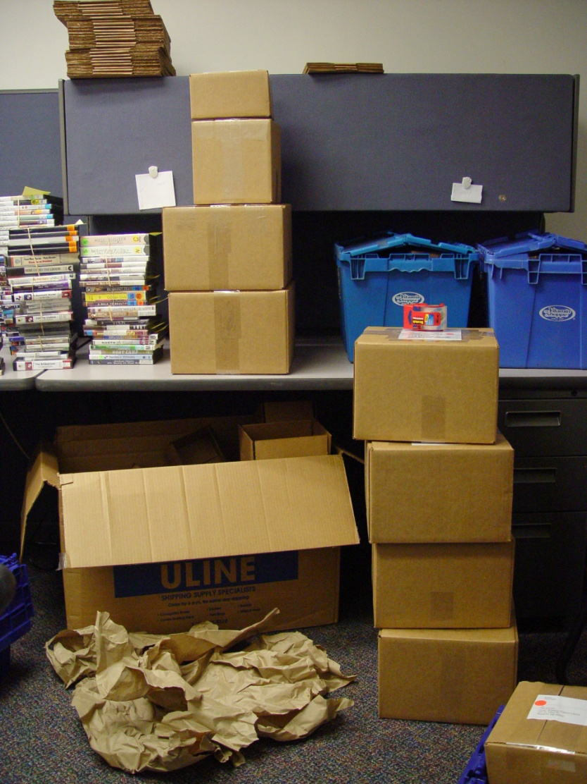
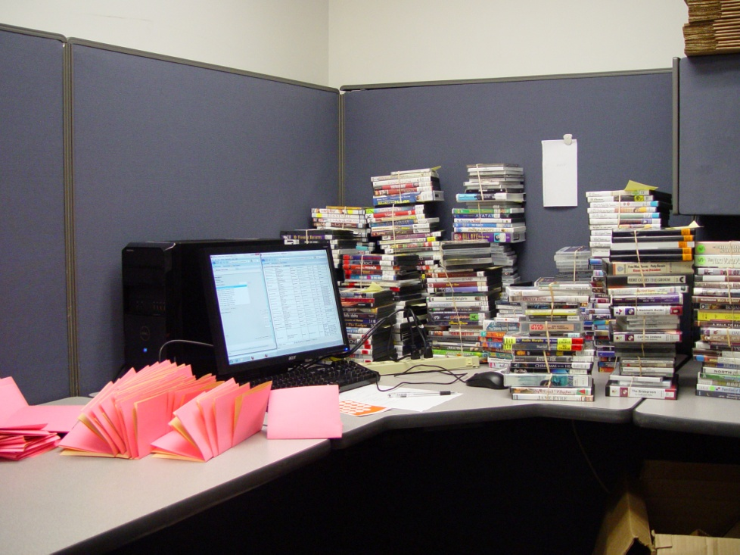
The Great Hub Heist
Notes:
Go to You Tube & search for Great Hub Heist - http://www.youtube.com/watch?v=EwZetWcSVQE&feature=youtube_gdata
About 675 items recovered
About 275 items reported lost

Slide 4
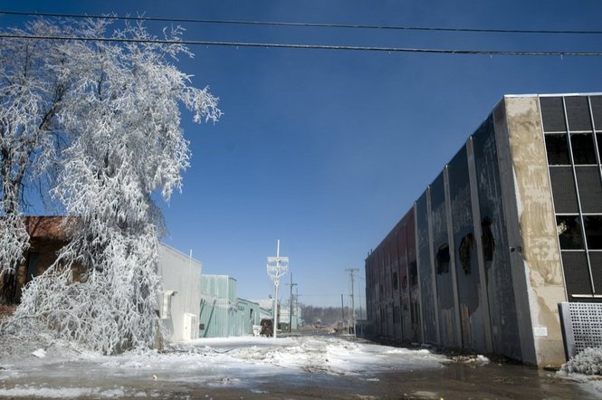
The Fire
The Accident

Slide 5
Survey Series
Service
Turn Around Time
Volume

Slide 6
Service Survey
Aug. 19 – Sept. 2
324 responses
Pack - 243
No Pack - 81
Notes:
RIDES stops at 397 individual places
64 of the 324 responses were from local delivery sites
260 = 65% of 397

Slide 7
Service Survey
As a rule, does your driver come on the days you have scheduled for service?
Yes 259
No 9

Slide 8
Service Survey
Have you submitted a RIDES Assistance Form in the last month?
Yes 56
No 268
Notes:
66 libraries reported damaged items
1 item = 32 reports
2 items = 15 reports
2+ items = 19 reports

Slide 9
Service Survey
As a rule, does your RIDES driver pick up everything that you have prepared to send?
Yes 264
No 4

Slide 10
Service Survey
Notes:
More than one answer could be selected. Responses from 260 delivery sites, as 89 respondents were either UP (Waltco) or local delivery service.

Slide 11
Turn Around Study
Survey dates: 9/19 – 10/14
# of Days of Delivery | Average Time to Send
2 | 4.8
3 | 5
4 | 4.7
5 | 5
Notes:
Does NOT include weekends
5 day a week – includes TLN, LLC, and SLC and other large central delivery sites – which add to days in transit.

Slide 12
Turn Around Study
Hub Zone | Number of Entries | Average Time to Send
100 | 271 | 4.28 days
101 | 168 | 5.5 days
200 | 201 | 5.1 days
300 | 178 | 5.2 days
400 | 555 | 4.4 days
500 | 496 | 5.4 days
700 | 218 | 5 days
OVERALL | 2087 | 5 days
Notes:
2535 submissions – 448 had to be removed because they did not comply with the survey guidelines. [no dates, dates prior to or after survey, library info not completed…]
Charts show days of delivery between regions [ 101 -> 100 = from UP to Grayling ]
100 = Grayling
101 = UP
200 = Grand Rapids
300 = Kalamazoo
400 = Flint
500 = Royal Oak
700 = Jackson

Slide 13
Turn Around Study
Notes:
100 = Grayling
101 = UP
200 = Grand Rapids
300 = Kalamazoo
400 = Flint
500 = Royal Oak
700 = Jackson

Slide 14
Turn Around Study
Notes:
100 = Grayling
101 = UP
200 = Grand Rapids
300 = Kalamazoo
400 = Flint
500 = Royal Oak
700 = Jackson

Slide 15
Turn Around Study
Notes:
100 = Grayling
101 = UP
200 = Grand Rapids
300 = Kalamazoo
400 = Flint
500 = Royal Oak
700 = Jackson

Slide 16
Volume Study
In progress until 11/11/11
First 250 reports from Monday and Tuesday
78 libraries reported receiving items in error, some had both
43 of those libraries reported that the error was Labeling Problem - i.e. Delivery label is correct, but item should have been sent to another library.
44 of those libraries reported that the error was Sorting problem - i.e. Item was labeled to go to another library.
At least 87 items in 2 days had to go back into the system
Effects turn around time
They appear to be lost in transit

Slide 17
More alike than we think…
Sorting
Libraries - gets other libs
ProMed - gets OCLC, TLN, no labels, odd sizes shapes, etc.
Workflow
Erratic loads, both outgoing and incoming
Missing
Libraries - missing books
ProMed – items missing labels

Slide 18
?
Sue Alt
MCLS
alts@mcls.org
800-530-9019 ext 143
Notes:
All in all – I think it is a miracle we get anything where it needs to be at all.

